Slide 1
Category review: Chips
May 2022
Retail Analytics
Brand note: If client logo is not required, use alternate title page layout right click slide thumbnail > Layout > Title

Slide 2
Notes:
To view Privacy video explaining how important data privacy is to Quantium, please click here: https://www.youtube.com/watch?v=Zq1QDAkoRzU
or here Q:\Company Reference\Brand & Design\Brand videos\Q Privacy.mp4
At Quantium, we believe that data is the behavioural footprint of humanity and that it has to be treated with the utmost care and responsibility.
Histories, attitudes, indeed lives are stored within it in ways that aren’t always apparent – and that’s what makes its potential so powerful.
To work with it responsibly, sensitively, we set ourselves the highest data privacy protection and governance standards.
We have spent 17 years perfecting privacy-by-design and secure-by-design principles. Central to this is not holding any personally identifiable information about people –
we neither receive it, and put the necessary protections in place to be unable to decipher it.
Every aspect of handling data is safeguarded: from its de-identification, to its encryption – data security is paramount and of the highest grade.
We pride ourselves on gaining the trust of iconic organisations around the world through years of securely working with their data,
and in turn the trust that builds with their stakeholders.

Slide 3
Executive summary
01
Task 1
Sales are coming mainly from Budget - older families, Mainstream - young singles/couples, and Mainstream - retirees
Mainstream young singles/couples are 23% more likely to purchase Tyrrells chips compared to the rest of the population
Mainstream young singles/couples are 56% less likely to buy Burger Rings compared to the rest of the population.
The increase in sales occurs in the lead-up to Christmas and that there are zero sales on Christmas day itself. This is due to shops being closed on Christmas day.
Most frequent product sizer purchased is 175 gr followed by the 150 gr size for all segments.
02
Task 2
Trial stores 77 and 86 have significant increase in total sales and number of customers during trial as compared to the control store.
Trial store 88 showed a lower increase compared to stores 77 and 86.

Slide 4
01
Category

Slide 5
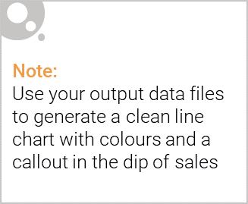
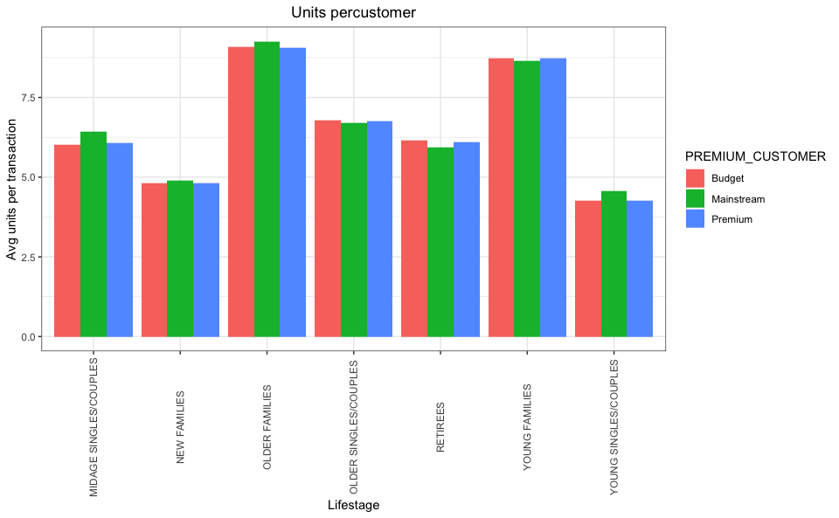
Older families and young families in general buy more chips per customer

Slide 6

1. Sales have mainly been due to Budget - older families, Mainstream - young singles/couples, and Mainstream- retirees shoppers.
2. We found that the high spending on chips for mainstream young singles/couples and retirees is due to more of them than other buyers.
3. Mainstream, mid-age, and young singles and couples are also more likely to pay more per packet of chips.

Slide 7
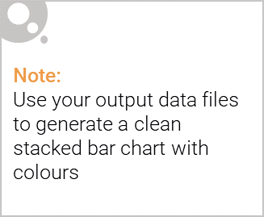
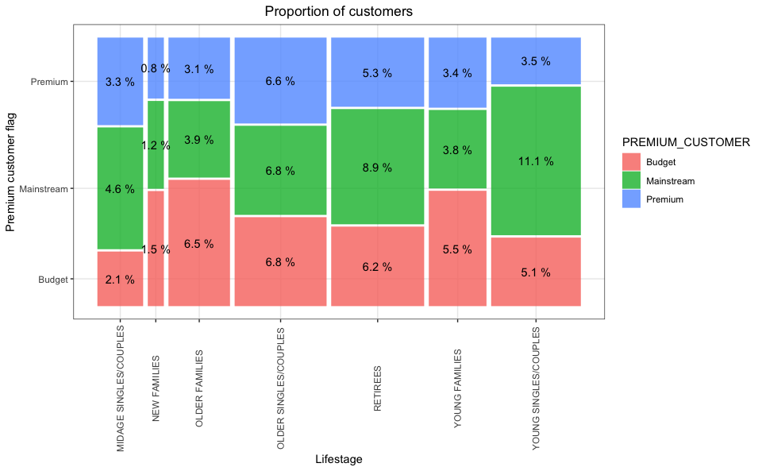
Editable (delete this)
There are more Mainstream - young singles/couples and Mainstream - retirees who buy chips. This contributes to there being more sales to these customer segments but this is not a major driver for the Budget - Older families segment.

Slide 8
02
Trial store performance

Slide 9
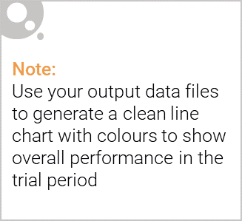
Evaluate the performance of a store trial which was performed in stores 77, 86 and 88.
Control stores were selected based on how similar monthly total sales in dollar amounts and monthly number of customers are to the trial stores.

Slide 10
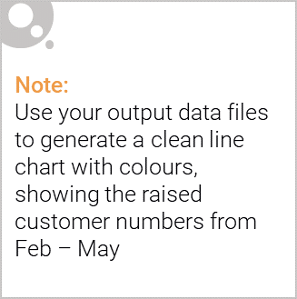
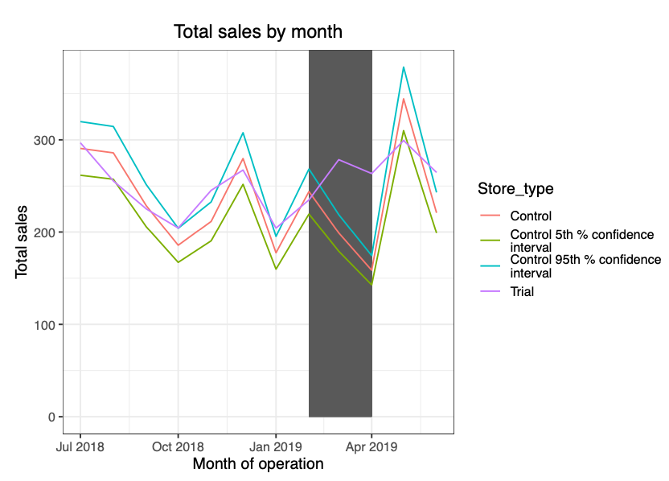
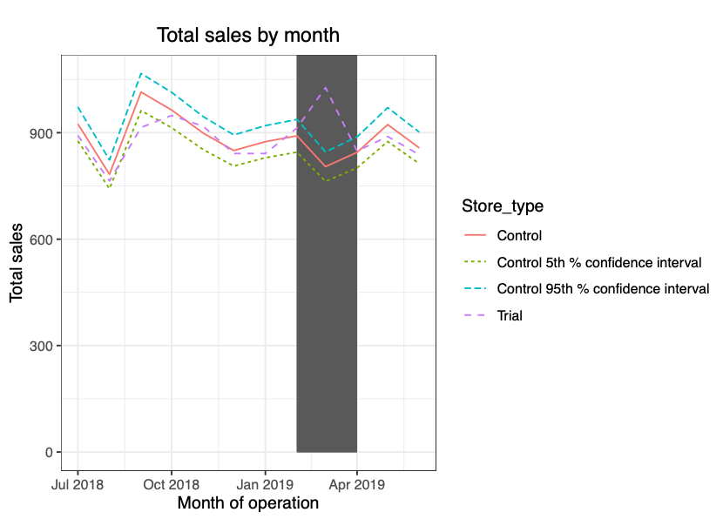
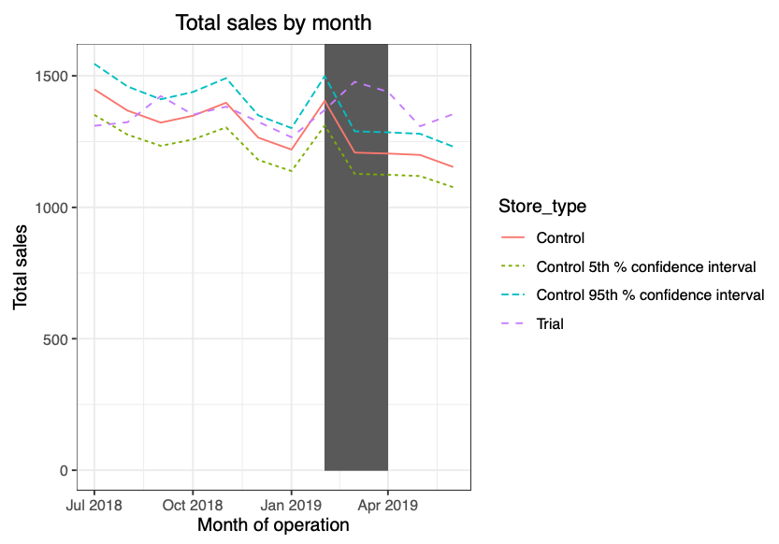
The trial in store 86 is not significantly different to its control store in the trial period
Store 77
Store 86
Store 88

